Slide 1
The dynamic optimisation of AGV (Automated Guided Vehicle)
(2022 ABB Smart Innovation Competition)
Tianyi7976@gmail.com
XJTLU Beamer Template
Tianyi Xiang Research Project
oct 23, 2023 5 / 15

Slide 2
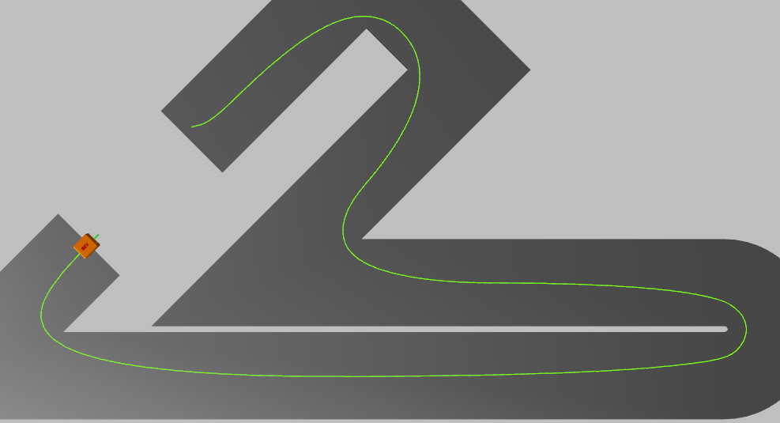
1.1 Project Structure
2022 ABB Smart Innovation Competition
Incorporate and design both the control algorithm and racing line optimization of an Automated Guided Vehicle (AGV) controlled by PLC
Analyze the friction range
Lap time
Control algorithm
Method
Evolution
Tire’s model
(with ground)
Energy use
Racing line optimization
Friction range

Slide 3
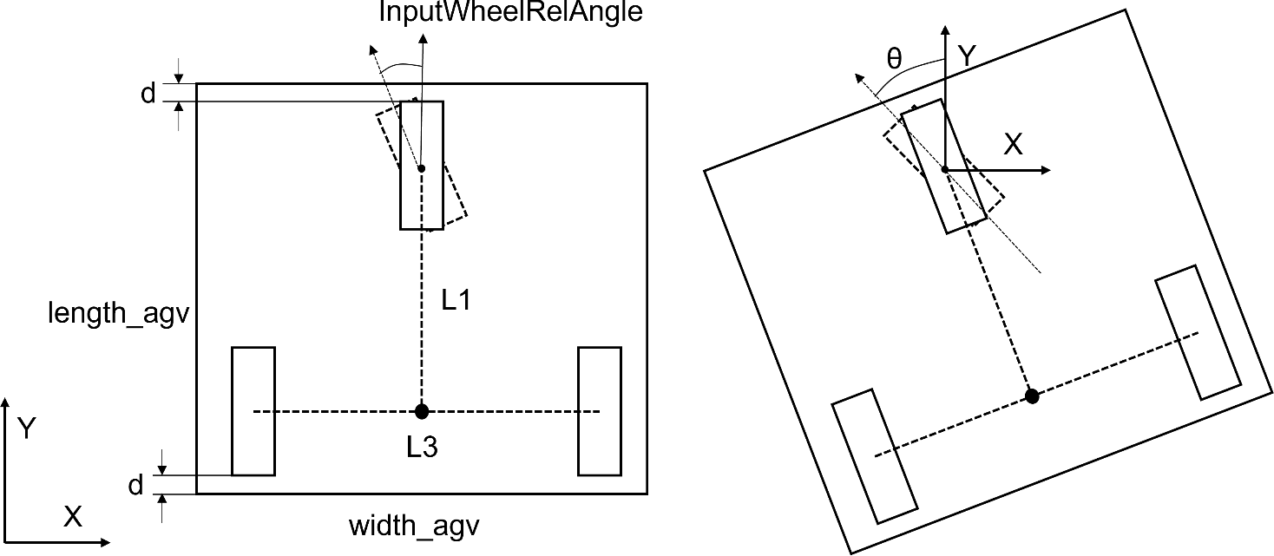
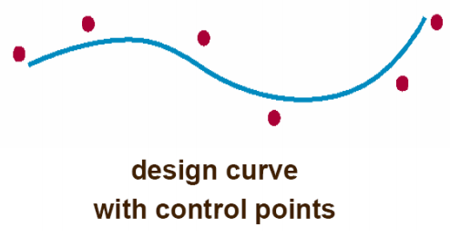
1.1 Method Evolution
First attempt: LQR + A
Valid: autonomous tuning;
Weak: implementing, slip at high curvature corner
Second attempt: Dual PID + B spline
Valid: high curvature corner;
Weak: AGV shake, Refresh not in time
Final version: Dual PID + Uniform B-spline + intelligent visual distance-refresh
Valid: suppressing the inevitable jitter due to PID; compensate the non-uniform trajectory points
Uniform B-spline Algorithms
Forward-feedback PID Controlling Algorithm
Self developed Intelligent target refreshing method

Slide 4
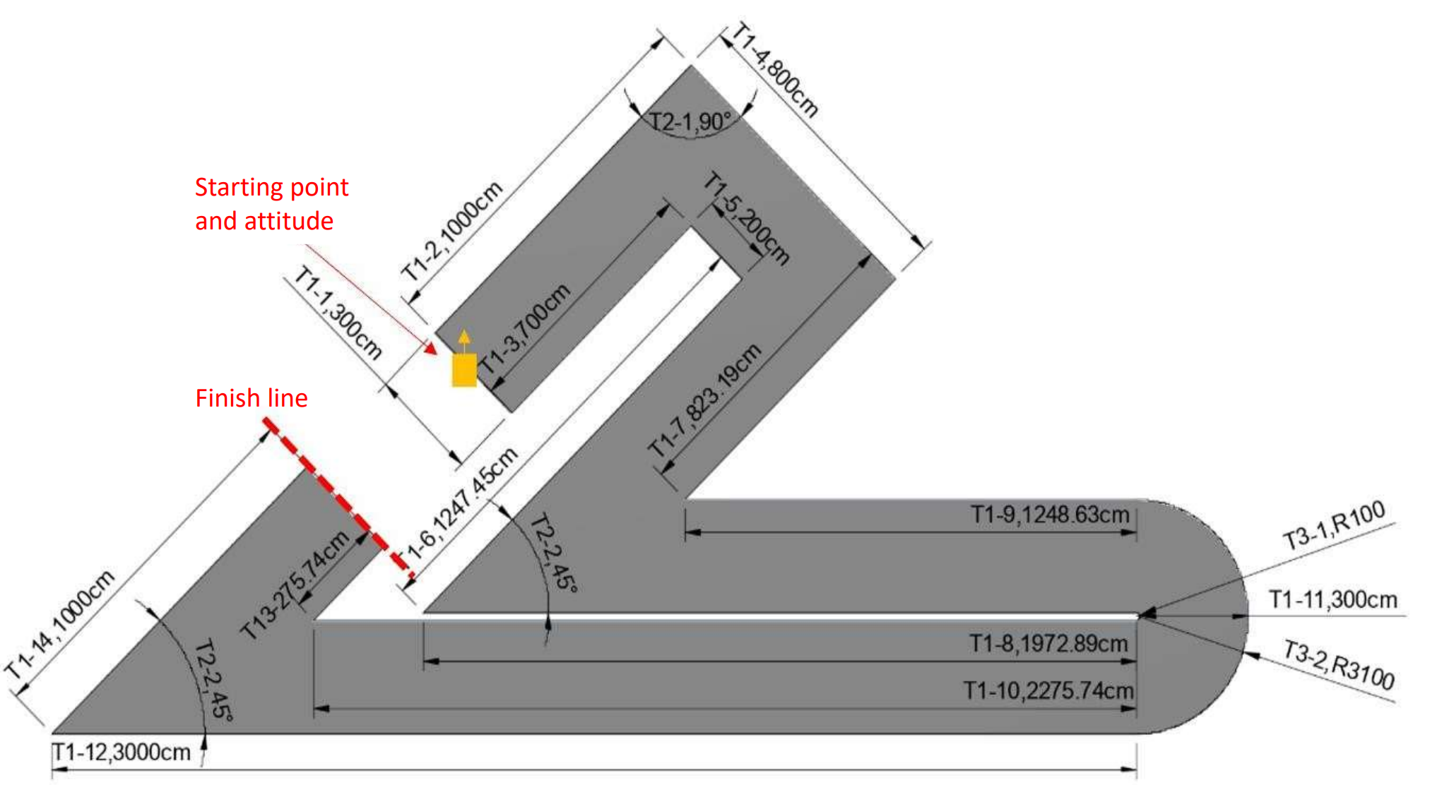
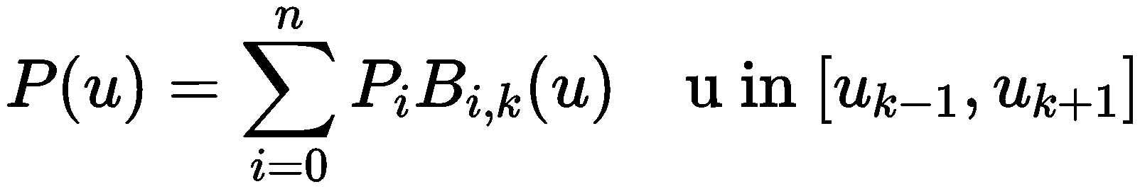
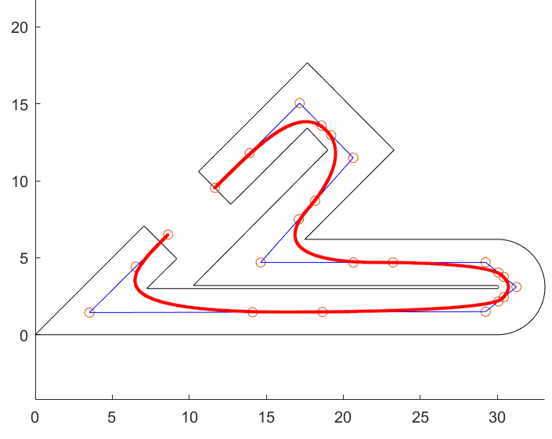
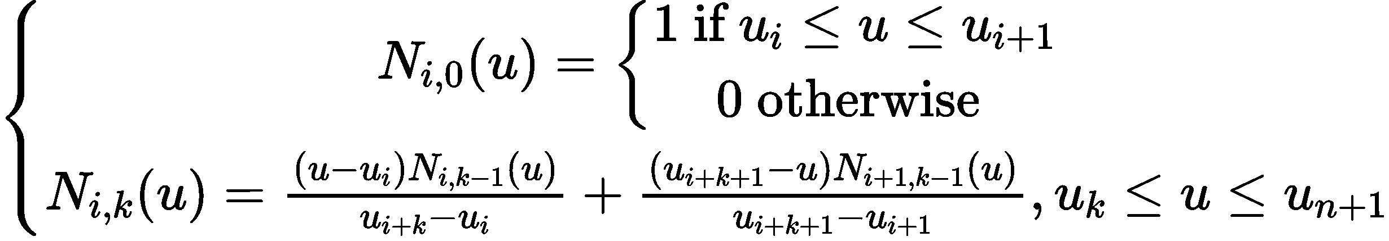
1.2 Uniform B-spline Algorithms
Transform the calibration curve into a design curve:
Uniform B spline curve, i.e., the distribution of target points in this curve are all equidistant.:
Determine control points by trail and inspection until the optimal result
The position of the node vector in relation to the neighboring vectors is determined according to the De Boer-Cox recursive formula.
Nodes vector is defined as a set of points dividing a curve into equidistant segments.

Slide 5
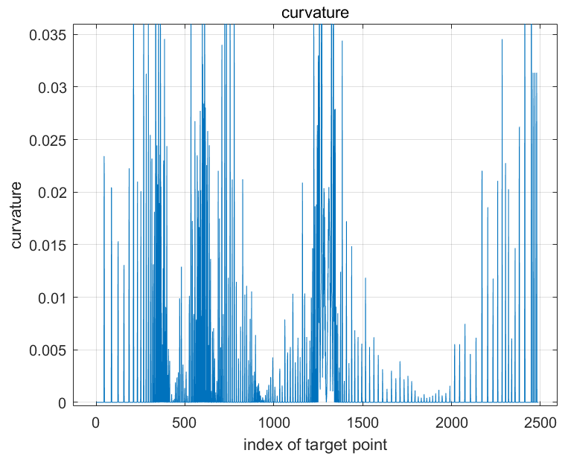
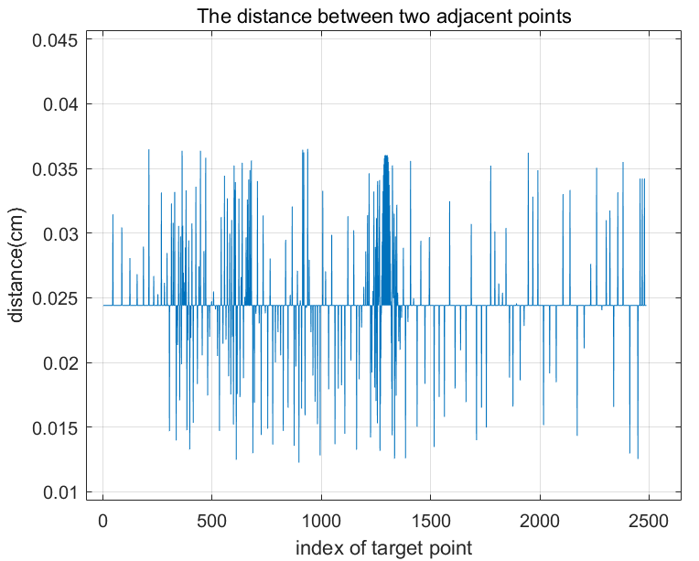
1.2 Uniform B-spline Algorithms
Fig.1.1 Curvature distribution of each target point
Fig.1.2 Adjacent distance distribution of each target point
The distribution of curvature is generally smooth without sudden changes
The adjacent distance validation between target points are restricted under 40%

Slide 6
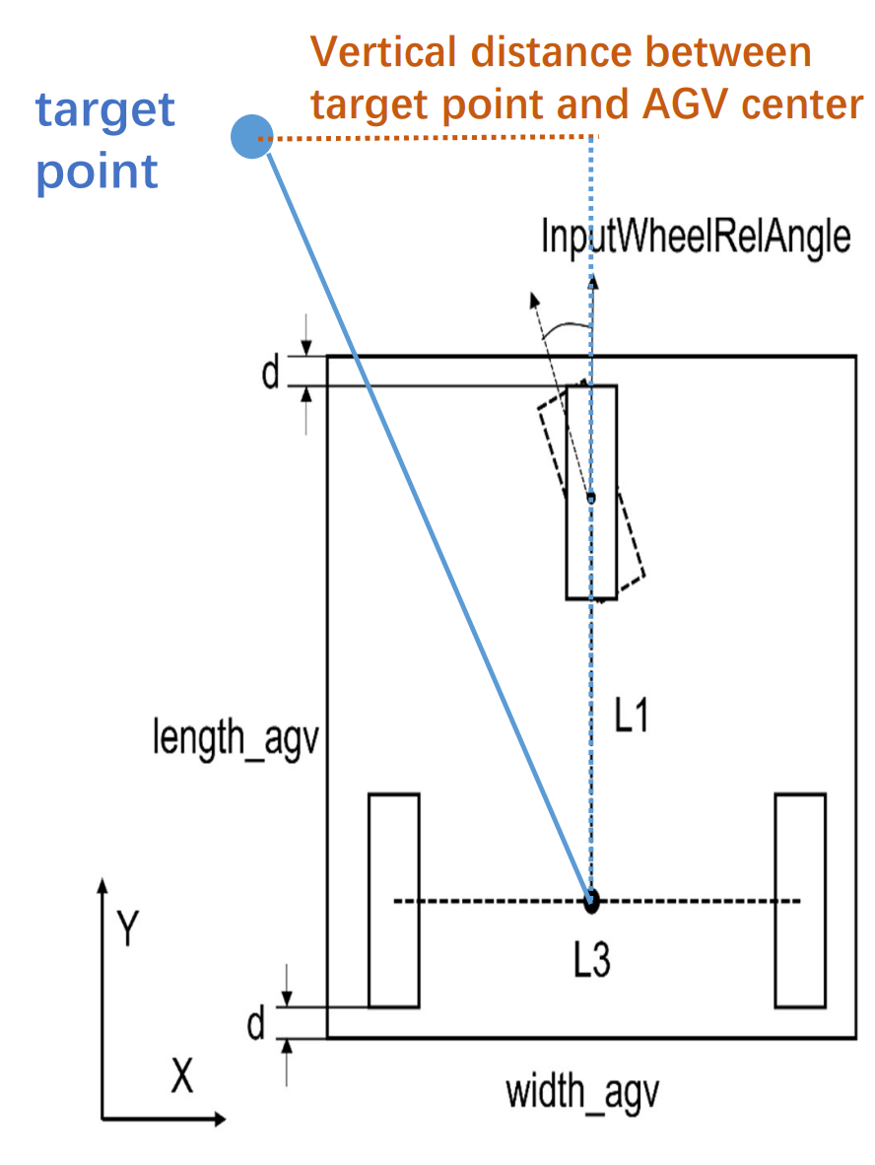
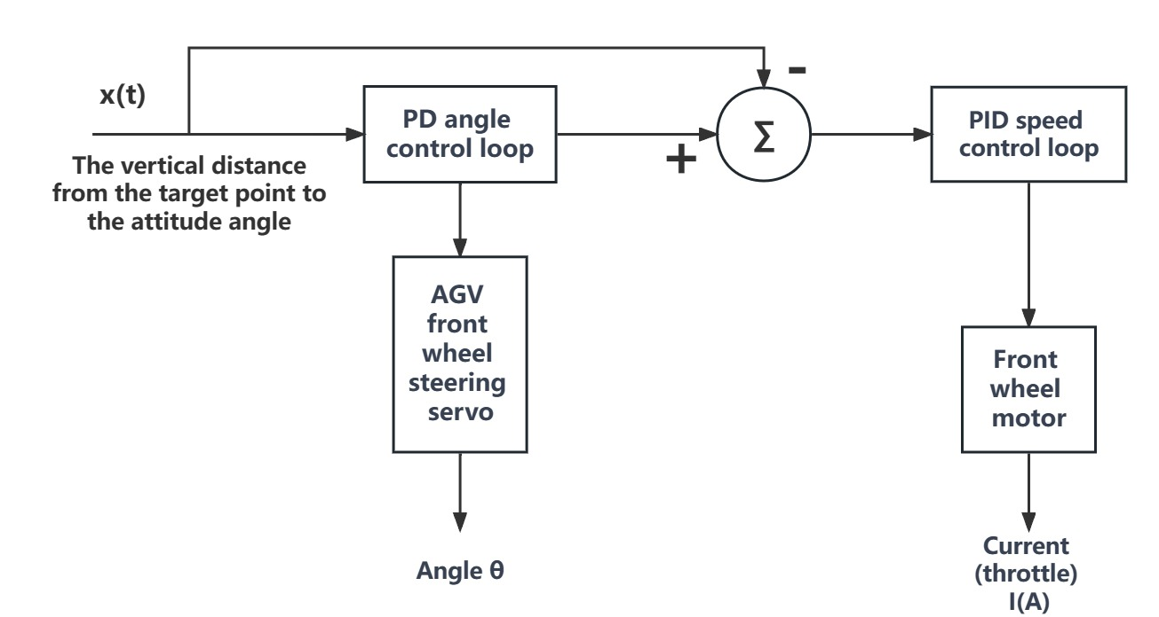
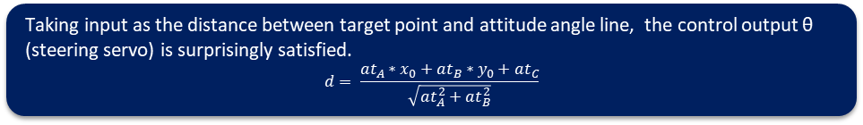
1.3.1 Dual PID & self-developed refreshing method
Taking input as the distance between target point and attitude angle line, the control output θ (steering servo) is surprisingly satisfied.
$$d= \frac{at_{A}∗x_{0}+at_{B}∗y_{0}+at_{C}}{\sqrt{at_{A}^{2}+at_{B}^{2}}}$$
Fig.1.3 The imply of the designed control algorithm
Fig.1.4 Dual PID control algorithm

Slide 7
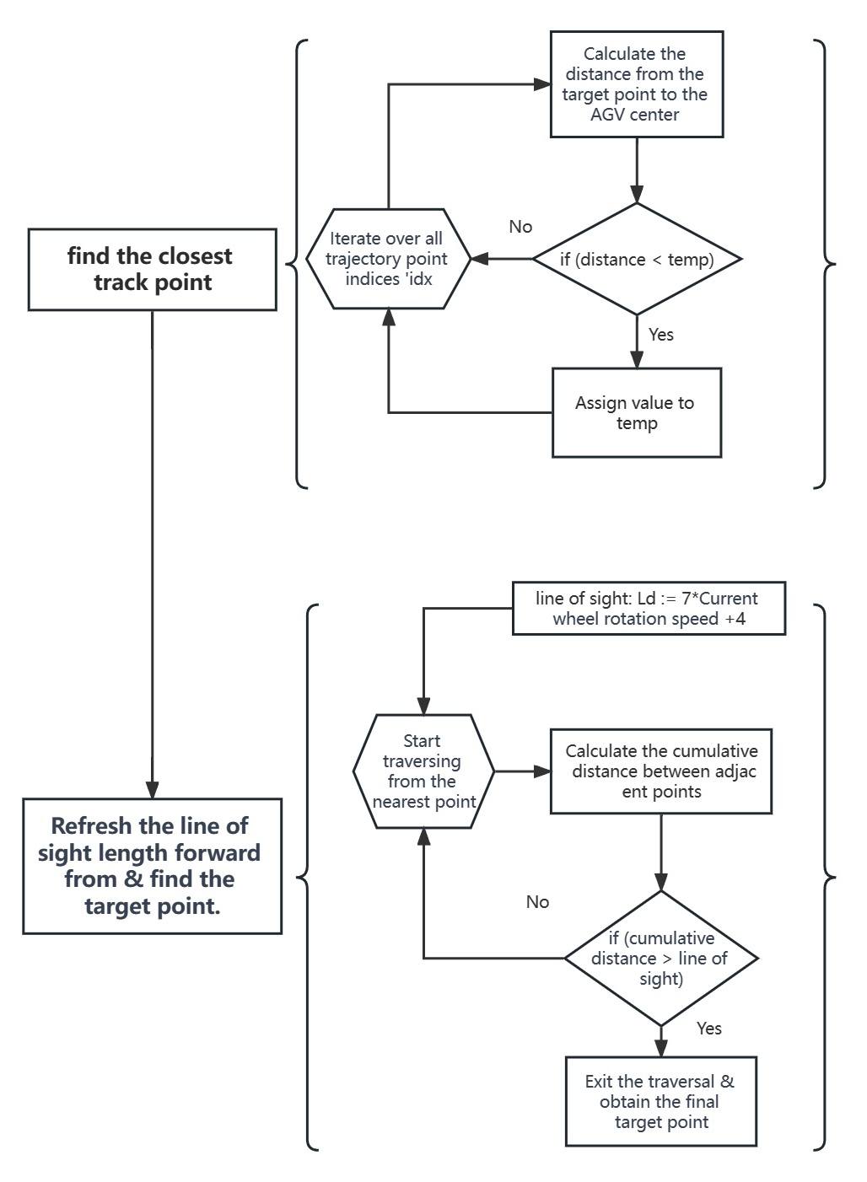
1.3.2 Dual PID & self-developed refreshing method
Higher speeds result in a more forward-looking update, enhancing road anticipation.
Excessively close line of sight can introduce errors, potentially causing deviations in the car's path.
Conclude the process when the cumulative distance of points along the reference trajectory surpasses the line of sight.

Slide 8
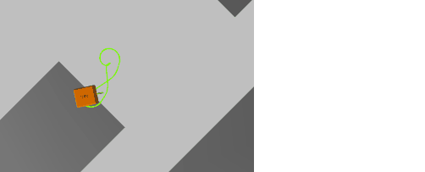


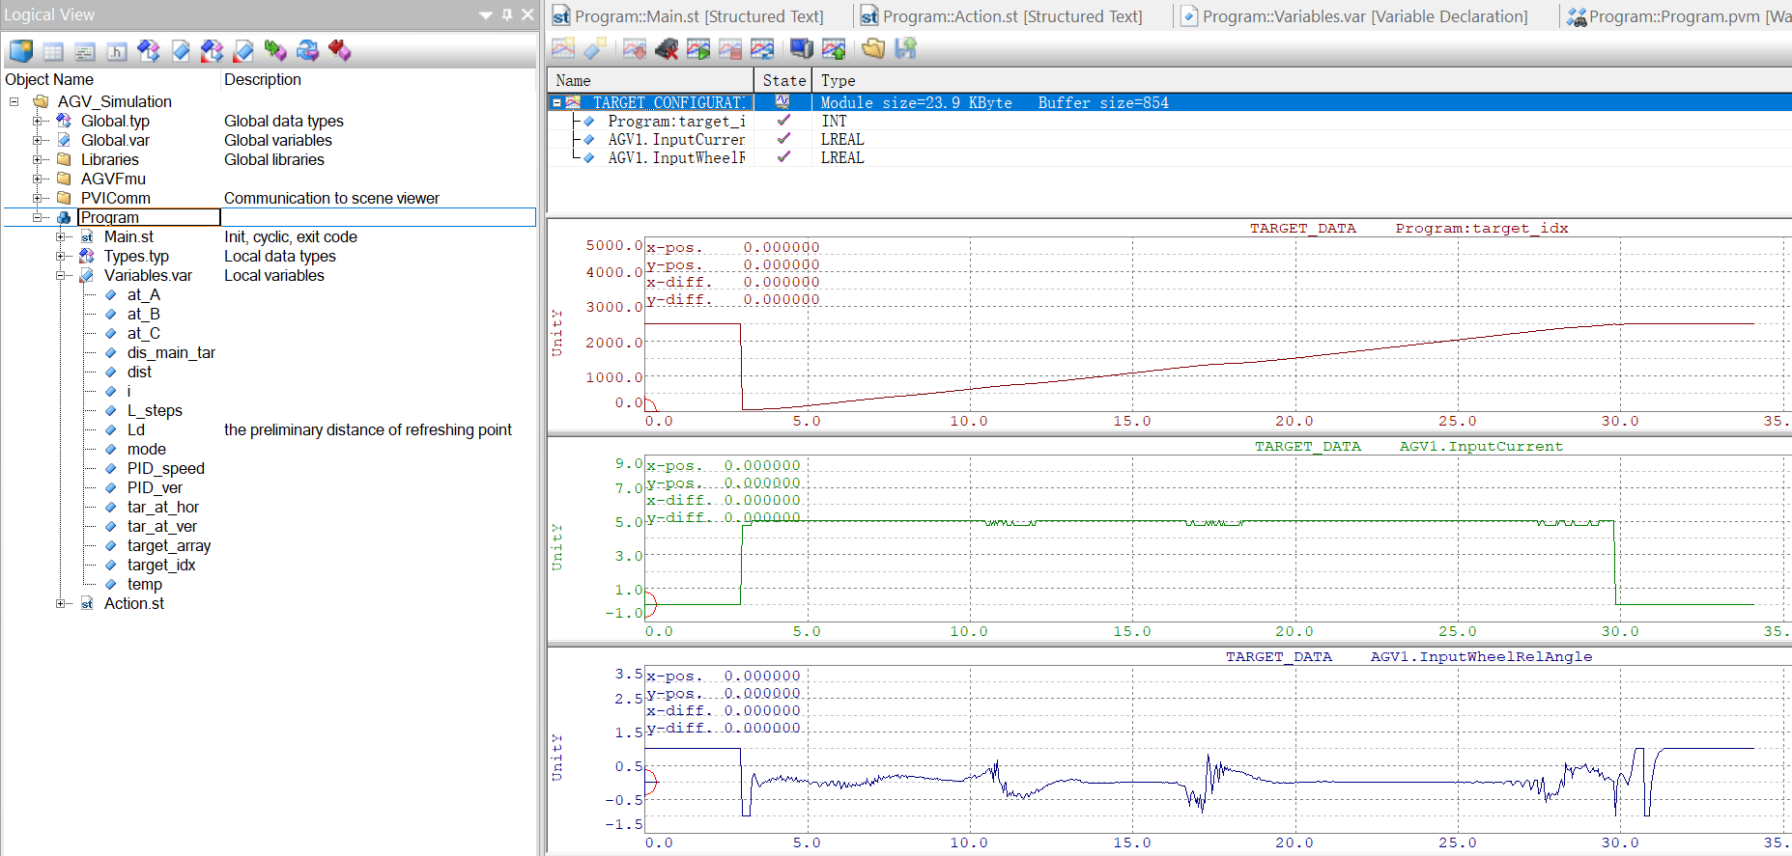
1. 4 Conclusion
Continuous tracking
Steer at corner
Refresh at U-shaped corner
The uniform B-spline could suppress the inevitable jitter
The intelligent line-of-sight could compensate the non-uniform trajectory points of B-spline
The vibration of wheel is without sudden change

Slide 9

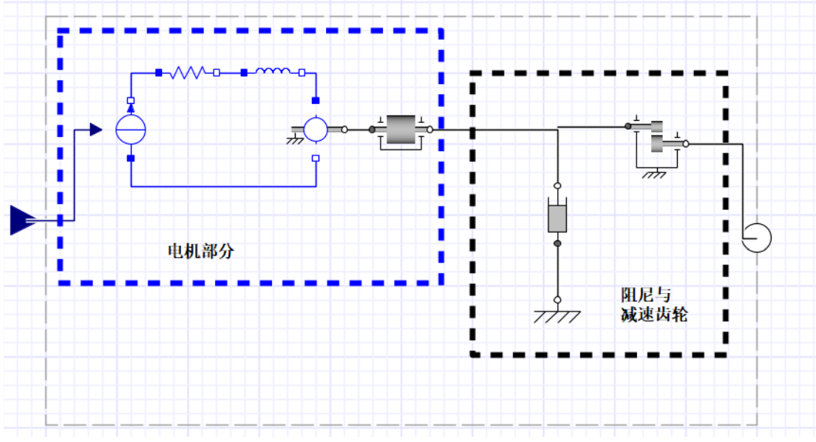
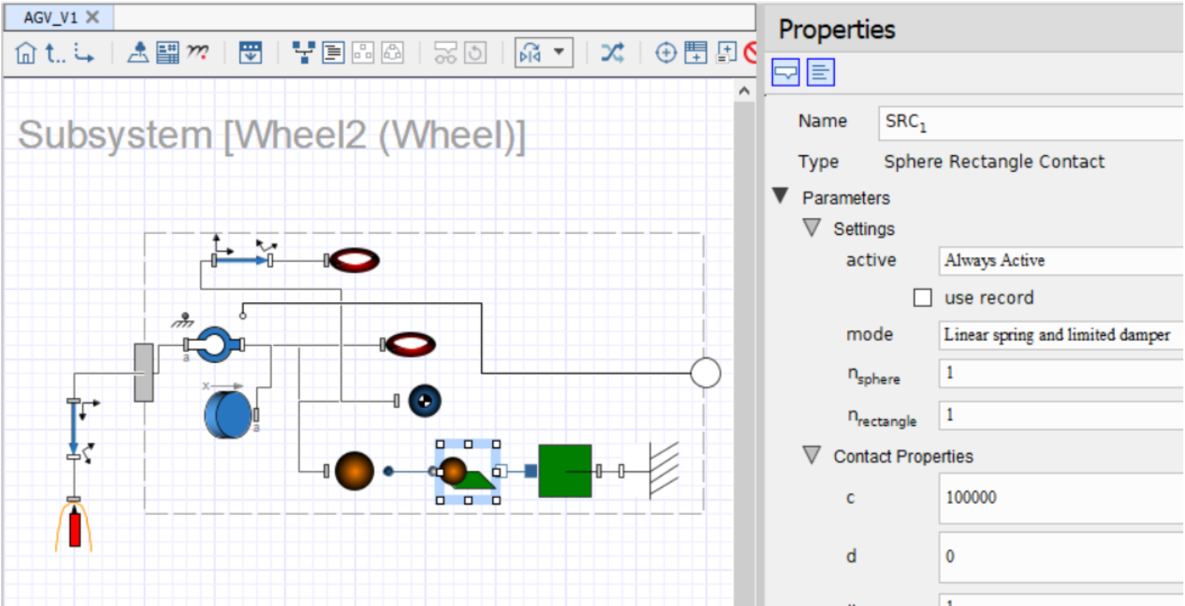
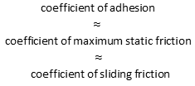
1. 5 Tire’s model
The industrial method is to approximate the sliding friction force coefficient as the adhesion coefficient using vehicle adhesion analysis. Then, compare the magnitude between traction and adhesion force.
$$\text{coefficient} \text{of} \text{adhesion}$$
$$\text{≈ }$$
$$\text{coefficient} \text{of} \text{maximum} \text{static} \text{friction}$$
$$\text{≈}$$
$$\text{coefficient} \text{of} \text{sliding} \text{friction}$$
Magic formular
Industrial method
approximation
Magic model
Motor part
Damper &
reduction gear
Fig.4 The motor and wheel modelling via MapleSim

Slide 10
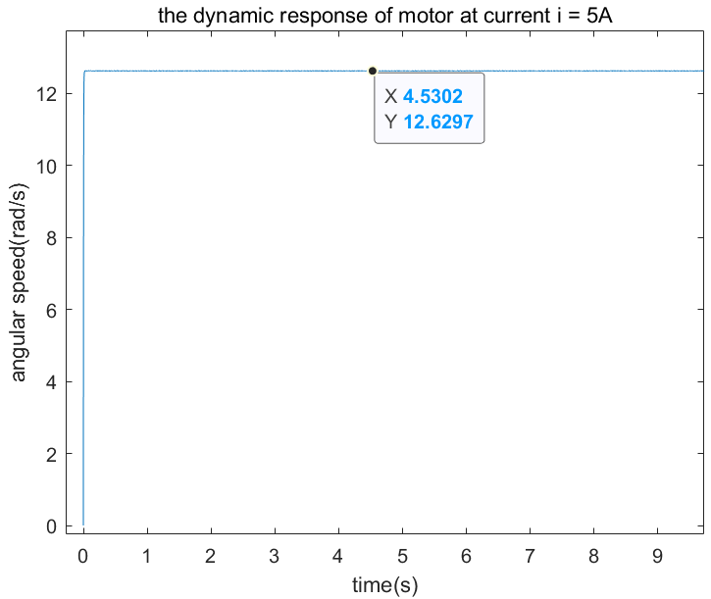

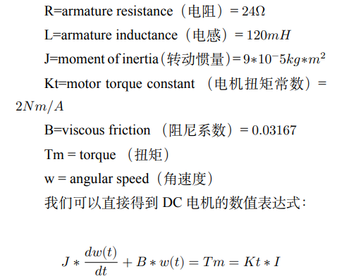
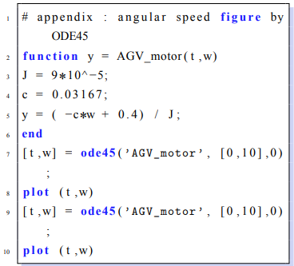
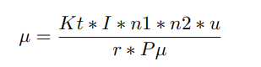
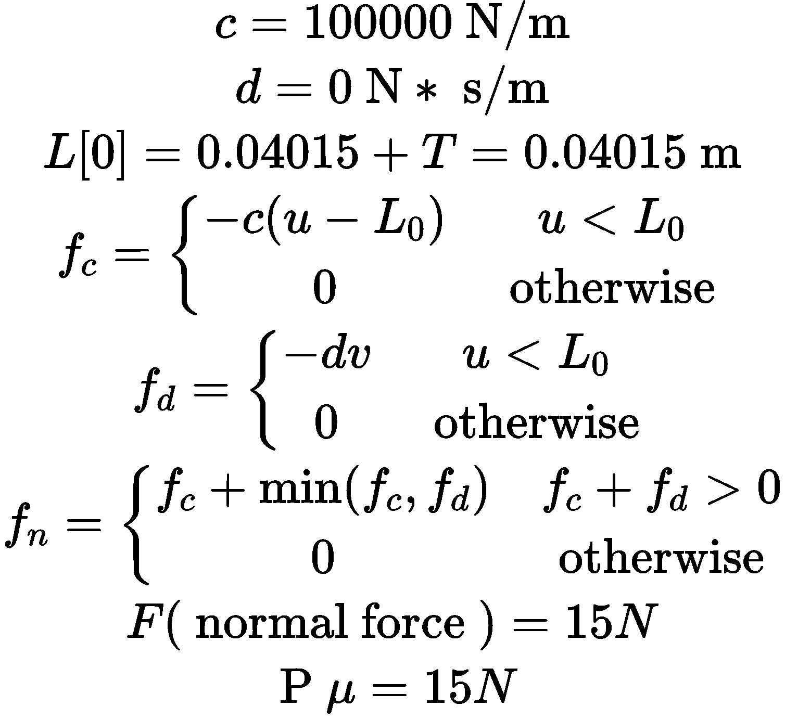

1. 5 Tire’s model
Approximate Conclusion
$$u>0.2175I$$
Dynamic response of DC AGV motor
Vehicle loading
analysis
Magic model
Fig.3 dynamic motor response when current i=5A

Slide 11
Continuous tracking
Steer at corner
Refresh at U-shaped corner

Slide 12
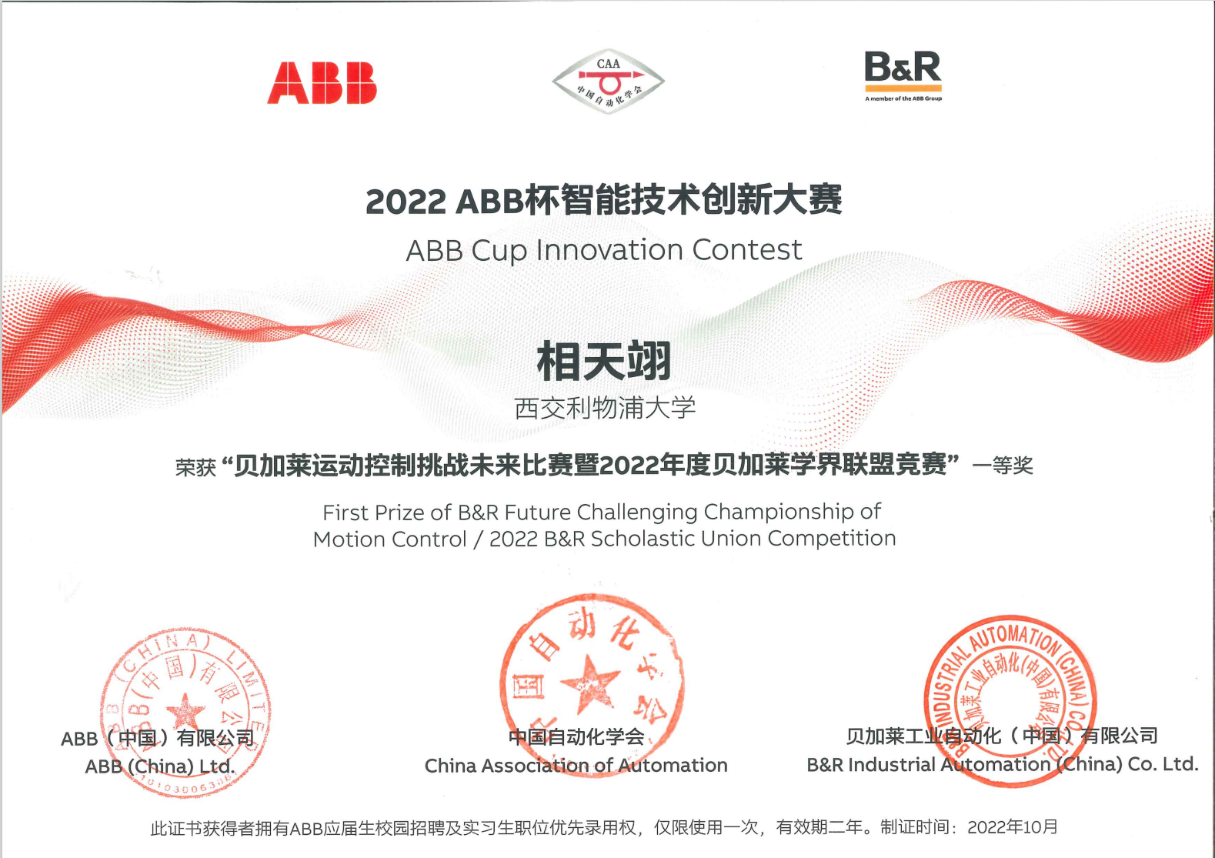
1. 6 Honor

